Slide 1
Evolution of Programming Languages
By: Transformers

Slide 2

What is “Programming”
Writing source code and turning it into a sequence of machine language instructions that the computer can execute.
Notes:
chandra

Slide 3
“Generations” of Programming Languages
First Generation
  Machine language
Second Generation
  Assembly language
Third Generation
  “High-level” languages such as C, C++, Java
Fourth Generation
  Scripting languages such as PHP, Python, Ruby.
Fifth Generation
  Natural language, Automatic code generation, Mercury, OPS5, and Prolog.
Notes:
chandra

Slide 4
Evolution of programming languages
Sequential Programming
Non Structured Programming
Structured Programming
Procedural Programming
Object Oriented Programming
Notes:
viral

Slide 5
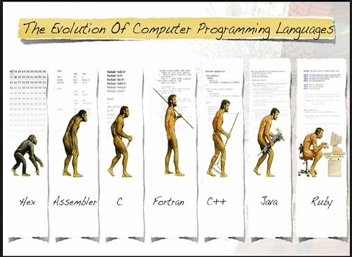
History of Programming Languages
Notes:
viral

Slide 6
Object Oriented Programming
OOP follows bottom –up approach.
Data is private and prevented from accessing external functions. Objects communicate with each other through functions.
One of the main principles of object-oriented programming language is encapsulation that everything an object will need must be inside of the object.
This language also emphasizes reusability through inheritance and the capacity to spread current implementations without having to change a great deal of code by using polymorphism.
Notes:
shaunak

Slide 7
Advantages Object Oriented Programming
OOP insists that you think about what you expose data to the outside world, it lets you change the implementation of an object without affecting any other code. (Encapsulation)
OOP allows you to have many different functions, all with the same name, all doing the same job, but on different data. (Polymorphism)
OOP lets you write generic code: which will work with a range of data, so you don't have to write basic stuff over, and over again. (Reuse)
OOP lets you write a set of functions, then expand them in different direction without changing or copying them in any way. (Inheritance)
Notes:
shaunak

Slide 8
Advantages Object Oriented Programming
Modularity for easier troubleshooting
  Something has gone wrong, and you have no idea where to look? When working with object-oriented programming languages, you know exactly where to look. “Oh, the car object broke down? The problem must be in the Car class!” You don’t have to muck through anything else.
  That’s the beauty of encapsulation. Objects are self-contained, and each bit of functionality does its own thing while leaving the other bits alone. Also, this modality allows an IT team to work on multiple objects simultaneously while minimizing the chance that one person might duplicate someone else’s functionality.
Reuse of code through inheritance
  Suppose that in addition to your Car object, one colleague needs a RaceCar object, and another needs a Limousine object. Everyone builds their objects separately but discover commonalities between them. In fact, each object is really just a different kind of Car. This is where the inheritance technique saves time: Create one generic class (Car), and then define the subclasses (RaceCar and Limousine) that are to inherit the generic class’s traits.
  What if you want to make a change to all Car objects, regardless of type? This is another advantage of the OO approach. Simply make a change to your Car class, and all car objects will simply inherit the new code.
Notes:
shaunak

